Slide 1
Gaussian Process Regression for Dummies
Greg Cox
Rich Shiffrin

Slide 2
Overview
We often wish to describe data by a function.
One-dimensional example:
Forgetting as function of delay from study to test
Multi-dimensional example:
A hand movement trajectory varies in time and in several spatial dimensions

Slide 3
Traditionally one characterizes such a relation with a parameterized function class:
E.g. Forgetting might be characterized by a one parameter exponential function or a two parameter power function.
Gaussian Process Regression (GPR) provides a different way of characterizing functions that does not require committing to a particular function class, but instead to the relation that different points on the function have to each other.
GPR can be used to characterize parameterized functions as a special case, but offers much more flexibility.

Slide 4
GPR offers powerful tools, and there are programs to apply it and an excellent book (both freely downloadable) by Rasmussen and Williams (Gaussian Processes for Machine Learning, the MIT Press, 2006, ISBN 026218253X).
However, most psychologists (and others) find it hard to understand conceptually what the approach does: The various articles, texts, and lectures inhibit understanding by ‘explaining’ the method with matrix algebra.

Slide 5
The ‘Gaussian’ part of GPR refers to the fact that all uncertainty, about any variables, or combinations of variables, is characterized by Gaussian distributions. For a one-dimensional distribution the Gaussian is characterized by a mean and variance. A multi-dimensional distribution is characterized by a multi-dimensional mean, and a multi-dimensional covariance. We can visualize the multi-dimensional Gaussian as an ellipse. E.g. in three dimensions this would be a ‘cigar’ shape.

Slide 6
It is easiest to explain and illustrate GPR by using GPR to characterize a simple parameterized function.
We will do so for the simplest function available: a linear function Y = aX + b + ε
a is the slope, b the intercept and ε Gaussian error
In turn we illustrate the cases in which only the intercept b varies, only the slope a varies, or both vary.
When only the intercept varies, we assume that a = 1.0 and ε = 1.0.

Slide 7
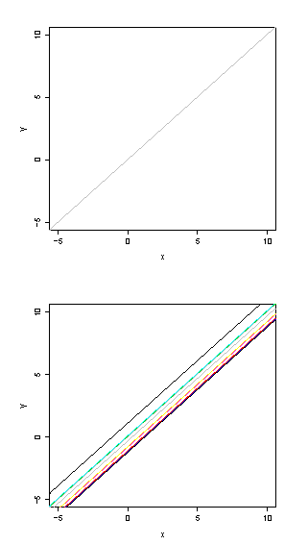
Linear regression
Notes:
We will illustrate with a simple example we all know, linear regression: Y = aX + b + e, where e is observation noise with mean zero and standard deviation z. For all today’s discussions, all distributions are assumed to be Gaussian.
For clarity in the discussion and figures, we will simplify further and assume a = 1.0 and z = 1.0. Thus all the lines vary only in the intercept.

Slide 8
The Bayesian approach is traditional: the parameter b has a prior distribution, and as data is collected (pairs-- Xi,Yi) we use Bayes Theorem to form a posterior distribution for b.

Slide 9
This approach is likely familiar and illustrated in two ways: On the left of the next figure, at the top, is the parameterized function. Just below we show the prior probability distribution of b (Gaussian) with a mean 0 and standard deviation ε = 1.0.
Below the prior we have the posterior distribution of b after observing the single data point Y = 2 given X = 3, derived from Bayes Theorem: The posterior is proportional to the prior times likelihood:
pd(b|2,3) ≈ p₀(b)p(2,3|b)

Slide 10
The posterior mean has dropped to -1/2, because we observed Y less than X, and the variance has dropped, because the data produces an improved estimate for b.
All the figures in the left column give the parameter space representation.

Slide 11
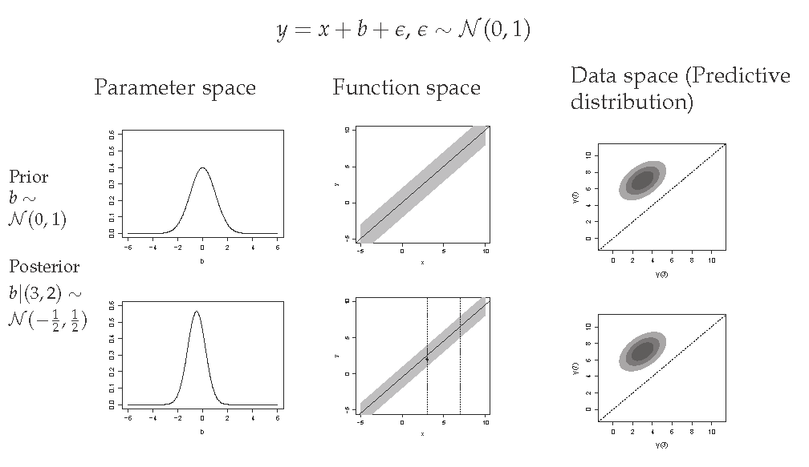
Bayesian linear regression
Notes:
We are familiar with the Bayesian approach, in which the parameters a, b and z have a prior distribution, and as data is collected
(pairs–Xi,Yi) we use Bayes Theorem to form a posterior distribution for those parameters.
In this case we only have prior and posterior distributions for b.
Thus we are familiar with two ways of looking at the situation: On the left of the figure, at the top, is the prior probability of b (Gaussian)
with a mean 0 and standard deviation s = 1.0.
On the left below we have the posterior distribution of b after observing the single data point Y = 3 given X = 2. This comes from Bayes
Theorem which says the posterior is proportional to the prior times likelihood: pd(b|3,2) p0(b)p(3,2|b)
The posterior has moved up and the variance has dropped.
In the middle of the ﬁgure on top we see the same idea shown in functional form: we see linear functions with slope 1.0, with a Gaussian
distribution of intercepts centered at (0,0).
In the ﬁgure below we see the posterior distribution of linear functions after observing (3,2). These have moved down, with lower s.d.
We have marked with vertical lines the distribution at the observed point X=3, and also (for reasons given soon) at the point X=7.
Note that the standard deviation of Y is the same at all X values, including the points X=3 and X=7.
This is a 2D Gaussian, albeit one correlated, because knowing the Y value at one X value helps determine the Y value at all others
(“helps” because independent observation noise occurs with each observation).
The correlation produces a prior and posterior distribution that are elliptical along the diagonal (cigar shaped).
Variation along the major diagonal reﬂects the uncertainty about b. Variation orthogonally represents observation noise.
To understand the connection between the Bayesian parameter approach to regression and the GPR representation of the same situation,
we must see how the left hand two columns in the ﬁgure (the usual treatment in parameter space) map onto the right hand two columns
(the GPR treatment in data space). Of course the middle column, showing the functions, is common to both treatments.
We have shown this GPR data Gaussian for just two points, but the same applies for any number of points: For N points we would have
an N-dimensional Gaussian, which one could try to imagine as an N-dimensional ellipsoid along the ‘major’ diagonal, with orthogonal
variance due to observation noise.
Nonetheless, that N-dimensional Gaussian inherits its mean and covariance from the linear function assumption.

Slide 12
The second column shows the same idea in a function space representation: In this case imagine the probability density rising out of the figure, with a darker region depicting higher probability.
We see a Gaussian spread of linear functions with slope 1.0. At X = 0, these are centered at Y = 0, as specified by the prior.
Below is the posterior: It has a lower variance Gaussian spread of linear functions. At X = 0 these are now centered at Y = -1/2.
We have marked with vertical lines the distributions at the (arbitrarily chosen) points X=2, X=4, X= 7, and X=9, because it helps us move to data space.

Slide 13
Note that the first column shows the distributions of the parameter defining the function, and the second column depicts the distributions of the functions themselves. These are duals of each other.
GPR uses yet another representation, one giving the joint distribution of selected Y points on the function. We have arbitrarily chosen to show this joint distribution at two pairs of Y values, one for the Y values at X=2 and X=9, and the other for Y values at X=4 and X=7.
(The technical treatises on GPR prove that not only this distribution, but all joint distributions of Y values (for N X values) are Gaussian, with some mean and covariance structure.)

Slide 14
The third column shows these two joint distributions, one for Y at X=2 and Y at X=9, and the other for Y at X=4 and Y at X = 7. We have placed the larger Y value on the vertical axis. Again imagine that probability density rises from the figure, and darker shading depicts higher probability.
These are ‘predictive’ distributions. For each pair of Y points, the top panel gives what two Y values are expected based on the prior, below is the same for the posterior.
This representation will not be familiar to viewers of this lecture, so some detailed explanation will aid understanding.

Slide 15
The vertical lines in the second column show the Y distributions at each of the four X values. The mean values at these points, 2, 4, 7, and 9 for the prior, and 1.5, 3.5, 6.5, and 8.5 for the posterior, must exactly match the center of the corresponding ellipse in the third column. E.g. 2,9 has a posterior ellipse center at 1.5,8.5.
But note that the distributions at various X values in the second column are not independent: The Y values are constrained to lie on a line of slope 1.0. Thus a high value for one Y must go with a high value for other Y’s, and low values must also go together. This is seen in the third column as distributions lying along a diagonal with slope 1. Without observation noise this would be a uni-dimensional distribution along the diagonal. However the two Y values have independent Gaussian noise added to them; this noise reduces the correlation and is seen as a spread of probability orthogonal to the diagonal, thereby producing an ellipse. Thus variation along the major diagonal reflects the uncertainty about b. Variation orthogonally represents observation noise.

Slide 16
Each of the ellipses in the third column depict the joint Gaussian distribution of Y at two chosen X values. These distributions are not equivalent to the parameter space and function space representations, because they only specify the relation between two X,Y points, for two different sets of points.
However when we add the fact that the same shaped distribution applies for any two Y values, with a center at X1-1/2 and X2-1/2, then all three representations become equivalent.
Choosing a random point from one of the GPR distribution(s) in the right column is equivalent to choosing a random point from the b distribution in column 1, using that intercept to predict mean Y values at the specified X values, and then adding independent samples of Gaussian noise to those two points. It is also equivalent to choosing random points from the distributions in column 2, at the specified X values (a pair of vertical lines).

Slide 17
The third column depicts the actual joint distribution. There is no room on the figure to give more columns so the next figure gives what would have been the fourth, fifth and sixth columns. These give the mean and covariance matrices corresponding to ellipses in the third column in the previous figure. The first for the pair of points---, the second for the pair of points ---, and the third for all four points (not represented in the prior figure because the ellipse would be four dimensional).
These matrices are the usual way that GPR is represented.

Slide 18
In this example the shape of the GPR distribution happens to be identical, save for the center, at every pair of points. This is not a general result, and in most cases the center and shape of the distribution will change for each different pair of points selected. (See the next example in which the slope rather than the intercept varies.) Nonetheless, knowing the distributions for each pair of points does provide a compete and equivalent description to the Bayesian regression.

Slide 19
Example 2
The next figure illustrates the same situation for the case with slope, a, varying (with intercept, b, fixed at 0). For the same observation as in the first example, Y=2 at X=3, the first column shows the prior and posterior distributions for the parameter a, and the second column shows the distributions of the functions, which go through the origin and spread out as distance from the origin increases.

Slide 20
The third column gives the joint GPR distributions for the two pairs of Y points, for X=(2,9) and X=(4,7). The distributions have different shapes (as well as different centers), in large part because variance increases with distance from the origin.
The final example is linear regression with both a and b as variables. In this case, one observation is not very informative, so we add another row to the figure, showing the posterior distributions when there is a second observation at (1,1).

Slide 21
Finish discussion of a,b

Slide 22
Our example was very simple: The parameterized functions were linear. One can think of linear regression as a sum of ‘weights’ (the two parameters) times two fixed ‘basis’ functions (a constant ‘1’ and y=x), plus added noise.
Nothing critical changes if we say Y equals a sum of N weights times N fully specified but arbitrarily shaped basis functions, plus noise. In GPR data space we still have a dual representation fully defined by a mean and covariance function defined for pairs of Y points.

Slide 23
Such a regression approach is highly flexible and can be used in many applications, and one might ask what is gained by developing a dual representation in data space.
There are a number of good answers, some of which will become clear later, but one is the fact that GPR does not require specifying particular functions but rather the relation of points on the desired function to each other.

Slide 24
Instead of specifying parameterized functions, let us start in data space directly, and assume some mean and covariance structure.
In the usual situation we have N observed data points presumed to lie on some unknown function. Let us assume we do not have prior knowledge that this function is in some simply stated parameterized class.
It is possible we might have prior knowledge which would allow us to make an educated guess about the mean of the GPR Gaussian(s). E.g. if we know that Y should be monotonically increasing we could incorporate that knowledge in the prior for the means.
However, in many situations we do not have such prior knowledge, or that knowledge is so weak we are willing to allow the data points to ‘speak for themselves’. In such cases we assume an uninformative prior for the means; for any pair of Y points the prior mean for that Gaussian (i.e. ‘ellipse’) is usually set to zero.

Slide 25
To use GPR effectively it is however necessary to make assumptions about the covariance or correlation structure. For example, we might want to impose a constraint that when X values are near each other, then the corresponding Y values are near each other. This tends to produce smoothly varying functions. We might go further and assume that this ‘nearness’ constraint falls off exponentially with distance of the X values from each other.

Slide 26
These constraints can be specified by setting the covariance of points Y(X1) and Y(X2) to be:
This is called a ‘kernel’. Note that this kernel function is parameterized. For example the parameter – controls how fast the Y values can vary as distance increases. When the observed Y values for nearby points vary considerably then this parameter will --------

Slide 27
In almost any application we are dealing with a finite and limited set of data points, and wish to predict only a finite set of points (perhaps one at a time), making the specification of the GPR model quite feasible. For N data points we would have N(N-1) covariance terms to represent the GPR Gaussian. Typically these would have some parameterized structure, reducing the number of to be estimated quantities.

Slide 28
Before going further, it would be wise to illustrate the use of GPR with a simple example. ???

Slide 29
The example we used to explain the connection of Bayesian regression to GPR was as simple as one could make it. Conceptual understanding is increased by considering a few generalizations.
??Consider first non-linear functions with one parameter. The logic is the same as before: For a given value of the parameter, knowing one point would tell you the values at all others (except for the added noise). However, the center and shape of the column 3 distribution would be different, and would be different for different pairs of points. ???

Slide 30
Next consider functions defined by more than one parameter. One simple example would be linear regression with both intercept and slope as parameters.

Slide 31
Note that GPR is used (usually) when we do not want to commit to a particular parameterized class of functions. Instead we deal with the joint distribution of some finite set of data points whose form is Gaussian, but whose mean and covariance comes not from a parameterized set of assumed functions, but instead from an assumed mean and covariance.

Slide 32
Given we assume no particular functional form we generally do not know how the mean changes from one x value to the next, so only specify the covariance. For N points this could be given as an N by N matrix of pairwise covariances, but that would be silly. Instead some simple parameterized covariance structure is assumed.
An example is an exponential distance covariance by which points covary highly when close and less so as a function of distance along the X axis. There might be two or three parameters of this assumed covariance structure and such parameters are usually termed hyperparameters.

Slide 33
The assumed covariance structure is termed the ‘kernel’.
Note that we do not know the implicitly defined class of functions that could give rise to the class of data Gaussians defined by the (parameterized) kernel. In fact there will generally be an infinite set of such functions consistent with some kernel. This is not a problem, but rather seen as a merit of the GPR approach: We use GPR when we do not know how to characterize the functions explicitly.

Slide 34
Once we define a covariance kernel, we can apply Bayes Theorem directly in the data space, producing both a posterior joint distribution for the data points, and joint distribution for the hyperparameters. Doing this requires a bit of matrix algebra.

Slide 35
In our simple regression example, we can write the covariance and mean as:
In this case we of course see b in the expression since b is the only unknown parameter in the regression.
Suppose we did not start with regression, but simply operated in data space and for some (unknown) reason assumed both the prior for b and this mean and covariance as a function of b. If so, then nothing would change, and the hyperparameter (as we now call it) has the same prior and posterior as we had in the simple regression.

Slide 36
This shows the main point: We can operate solely in data space and assume a covariance (and mean) kernel. We can also assume a prior for either the data point Gaussian or for the hyperparameters (these are duals of each other; given the kernel one implies the other). Given some data we then apply Bayesian analysis as usual and produce either a posterior data Gaussian or a posterior for the hyperparameters (these are duals of each other, again).

Slide 37
Suppose we operate solely in data space, the usual GPR approach. We now see that the analysis depends completely on the assumed kernel. So far we have mentioned just two, one corresponding to our simple linear regression and one based on exponential distance (we will say more about this in a moment).

Slide 38
Many kernels have been identified (with different properties that are useful for different settings), such as:

Slide 39
A real world example: A few years ago, Dan Little and I decided to investigate how people (scientists) formed guesses about the form of causal relation that underlies 2D noisy data.

Slide 40
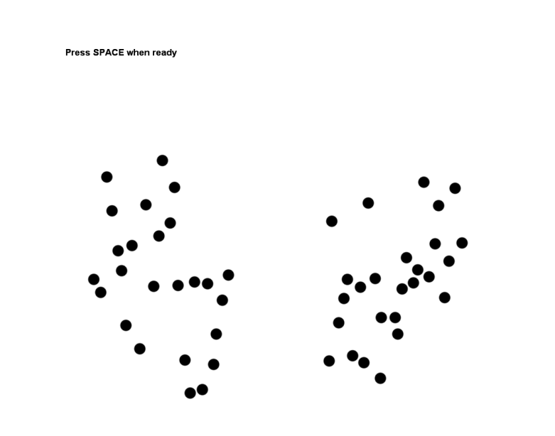
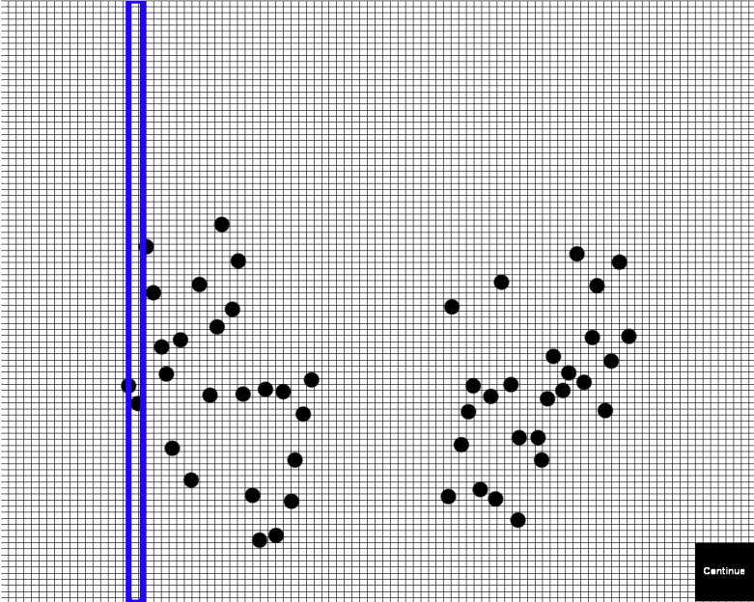
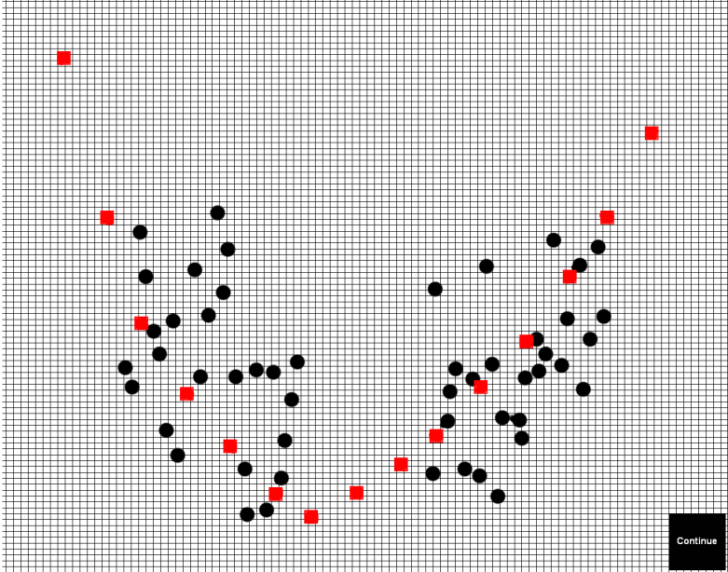
Experiment 1:
Participants responded at
various locations on the graph
Responses
time
Notes:
In one version:
1) P’s view the data and develop a mental function 2) They respond to prompts at various points on the graph 3) Each point is removed to lessen the influence of the response function on responding 4) At the end, all of the response points are presented and P’s can smooth the response

Slide 41
We assumed that the guesses about functional form could be of two types. One was parameterized functions. We tried low order polynomials (e.g.
Y = a + bX + cX² + dX³ + eX⁴ + z
But often people would choose to simply draw smooth curves through the data as in the example below:

Slide 42
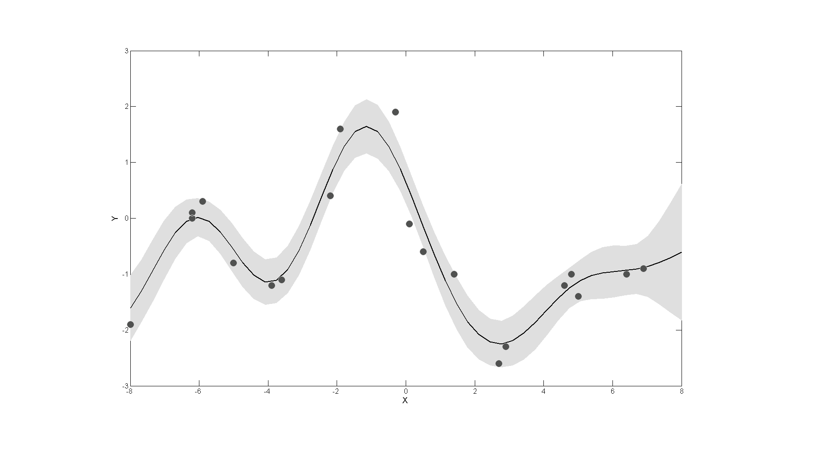
Similarity-based Functions
Notes:
Exponential weighting is familiar because it is what is used in similarity based models of categorization (like GCM).
Actually, the process is a bit more complicated: We use the similarity function to create a covariance matrix – between all of the x-values - for a multivariate Gaussian distribution. We then conditionalize on the data that we observe to make predictions for new data. This is called Gaussian Process Regression. The covariance matrix is represented by a kernel function. A kernel function exists for this exponential similarity function. The picture above shows the posterior for the distance based ‘follow-the-data’ functions. However, kernel functions exist also for each polynomial degree, and kernels can generally be combined, allowing predictions and inference to be made for combinations of functions, such as polynomials plus distance based ‘follow-the-data’.

Slide 43
To model both these cases we used GPR. The next slides show:
the exponential distance kernel we used for modeling smooth tracking, and….
the polynomial kernel we used to model parameterized functions.

Slide 44
Function hypotheses
Notes:
We consider 5 different kernel functions: The first four are polynomial degrees 1 to 4. Each polynomial kernel projects the input x-values into the appropriate polynomial feature space (including an intercept; e.g., quadratics would include project a single x value into a ternary dimensioned input with x^0, x^1 and x^2). Each input ‘dimension’ has a hyperparameter on the diagonal of the ‘prior covariance matrix’ (sigma sub-P). Note that normally distributed noise is also added to the kernel function.

Slide 45
Function hypotheses
Notes:
We also include what I’ll call a similarity-based kernel for reasons which will become clear in a moment. This kernel computes the squared exponential distance between each input x-value. Again noise is added to the distances. Exponential distance is familiar because it is used in many similarity-based models including the GCM.

Slide 46
We applied this ‘mixture’ model both to the displayed noisy data pattern on a trial (showing the Bayesian posterior implied by the model for that data), and to the data produced by the observer (showing the posterior for the observer’s guessed function).

Slide 47
There were many interesting findings. For example, the analysis showed that some people seemed to prefer low order polynomials (linear mostly) and others smooth tracking, but all used some of each, depending on the particular set of data. [There was much more to the study and analysis, but this talk is about understanding GPR].

